Slide 1
Introduction to Ideation
Foundations of Engineering Practice
Notes:
In this workshop, you will have a chance to practice your creativity. Ideation is the process of creating new ideas.

Slide 2
Today’s Program
Practise using some brainstorming methods to explore problems:
Activity 1: Create a Why-Why diagram
Activity 2: Create an Affinity diagram of ideas
Notes:
After ideation workshop, students should be able to:
Use brainstorming methods to create ideas for design projects
Be able to create an affinity diagram to help organize ideas from a brainstorming session
Be able to create a why-why diagram to explore and consider the causes of a problem to help create the best design solution

Slide 3
Activity 1: Why-why diagram
Problem: Unhappy airport passengers
Recall the online pre-workshop exercise:
Ways to mollify airport passengers.
Now look at the causes:
Why do airport passengers need to be mollified?
Activity:
Form groups of 5-6 students
Discuss need, target audience, and impact
Create a why-why diagram to help evaluate need and impact
Stick to causes, park any solution ideas
Notes:
Facilitator notes:
Recall the online Pre-Workshop exercise: Mash-up on mollifying delayed passengers at airports
Asked to identify 1) all aspects of the airport experience 2) Experiences people enjoy
And then to mash these items from each list together.
Any solutions you developed focused on Treating the immediate symptoms
This time, students are asked to focus on understanding the problem “Why do airport passengers need to be mollified?”
Try to find the root causes / source of the problem
Define the problem to allow solutions that either prevent (deal with the causes) or mitigate (deal with the symptoms) the problem

Slide 4
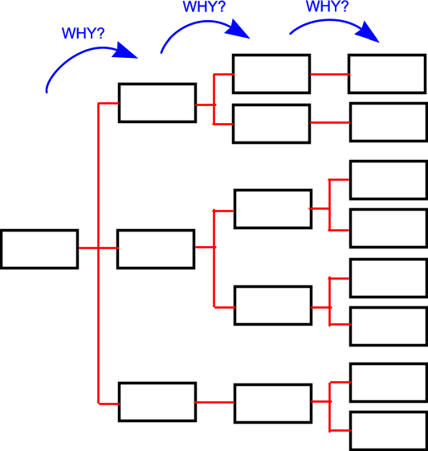
Why-Why Diagram Overview
Gate doesn’t latch
Latch mis-aligned
Gate has sagged
Latch post leaning
Latch is broken
Bent catch
Missing pin
Rusted
Gate too big
Gate wood has swollen
Notes:
Facilitator notes:
Give students big sheets of flip board paper and markers to create their diagrams
After 10 minutes ask teams to come forward to with their insights as to the cause of the unhappy passengers at the airport
Challenge them if they are slipping into solutions
Collect the most insightful explorations of the problem – on board
Are their some causes that can clearly be addressed to avoid having to mollify passengers in the first place?
Ask teams to share solutions that came along while they were exploring the causes

Slide 5
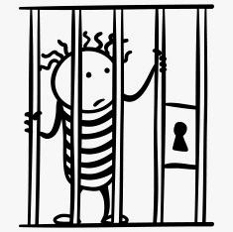
Activity 2: Affinity diagram
Recognition of need
A loved one has been sentenced to jail
Conditions are horrible
Loved one is suffering
You want to help

Slide 6

Activity 2: Affinity diagram
Problem definition
Decide to help by smuggling contraband into jail in a cake
Need to decide on what items to smuggle - OBJECTIVES
Need to know cake dimensions - CONSTRAINTS
Notes:
Facilitator notes:
Students need to work out what they want to send to their loved one!
But keep in mind how to make the best use possible of the “cake” constraint

Slide 7

Information Gathering & Research
3 cake layers - each layer has a diameter of 21 cm and is 3.5 cm high
Cake box has dimensions of 25.5 cm wide x 25.5 cm deep x 12.5 cm high

Slide 8
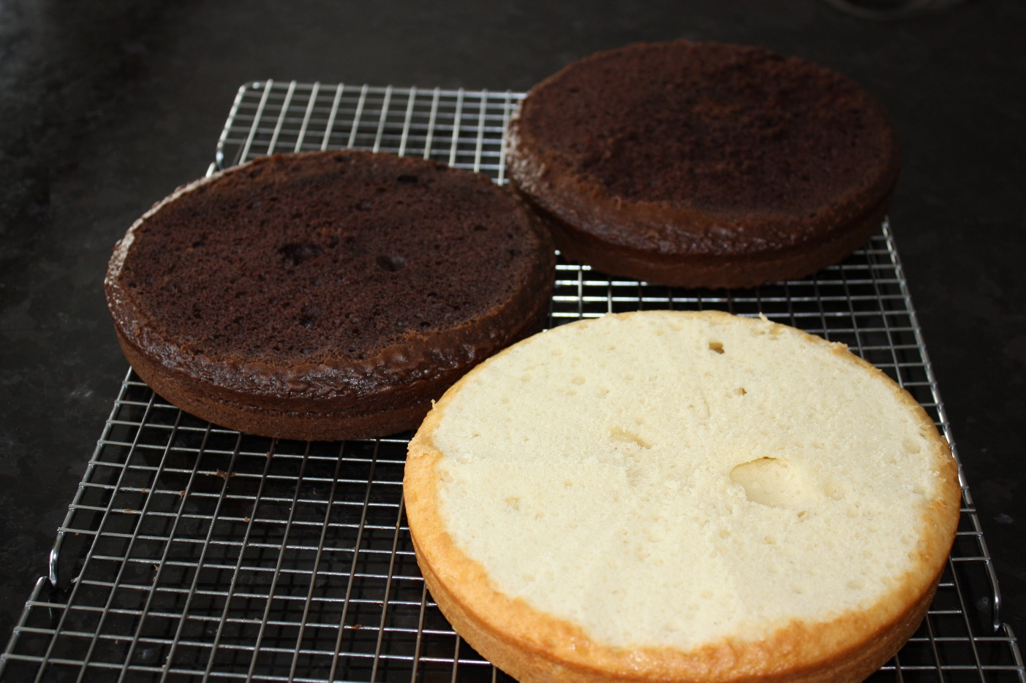
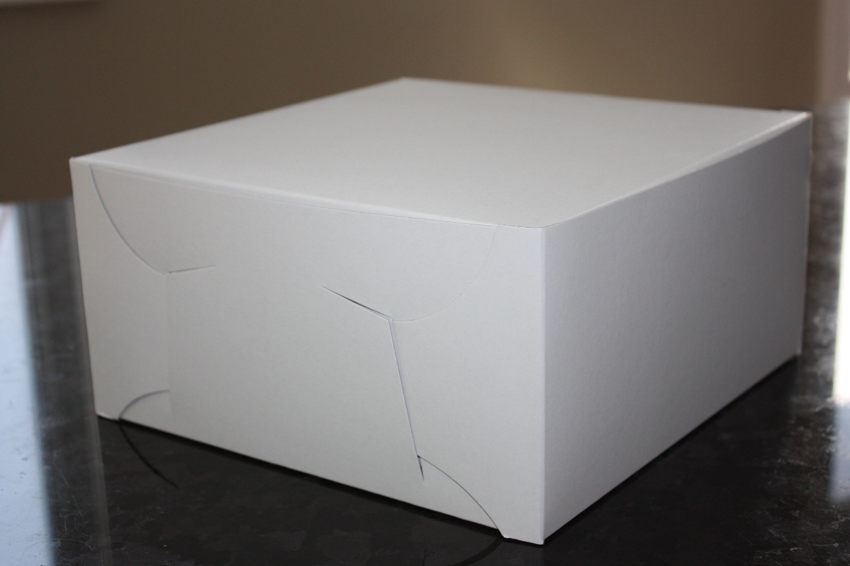
Activity 2: Cake Visuals
3 cake layers - each layer has a diameter of 21 cm and is 3.5 cm high
Cake box has dimensions of 25.5 cm wide x 25.5 cm deep x 12.5 cm high

Slide 9
Activity 2: Affinity diagram
Generation of concepts & diagram
Form teams of 4 – 6 students
Individually:
Silently write ideas on cards/post-it notes
One idea per card
Team:
Present ideas to each other
Organize ideas into an affinity diagram – expand ideas
Compare affinity diagrams with neighbouring teams
Notes:
Facilitator notes:
(– give them postits to write them on,
and a flipboard sheet to arrange them on after,
a marker or two for labelling the categories,
and painter’s tape to stick sheet to wall)
3-5 minutes complete silence on solo ideas to send
10 minutes to arrange into categories ← consider new categories, expand on items in each category
3-5 minutes to compare results with other teams

Slide 10
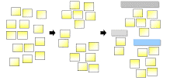
Diagram Process
Capture Group Label
Any categories suggesting new categories?
Any categories low on ideas?
Notes:
Facilitator notes:
Remind teams to consider any categories that seem under representative – more ideas for those
Do the categories suggest other potential categories for more ideas – “Sports equipment” might suggest “hobby supplies” or “Educational” or “Exercise”
When time is up ask teams to offer up their best ideas and have class vote on best idea
Illustrate possible result with following slides.

Slide 11
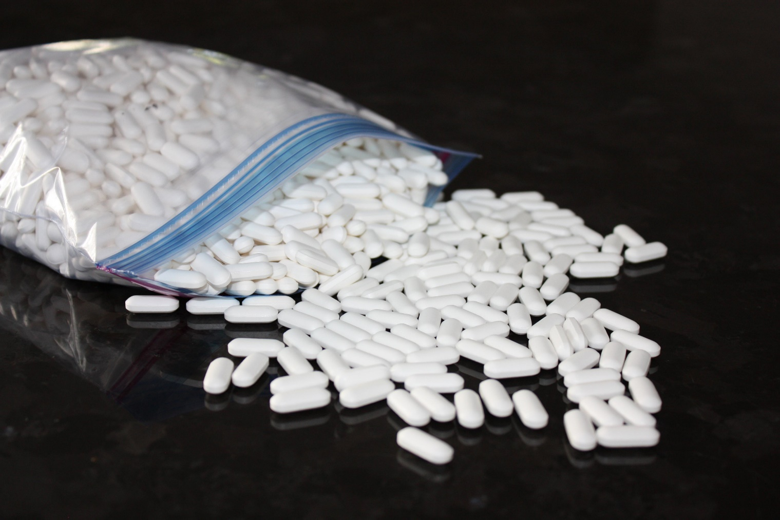
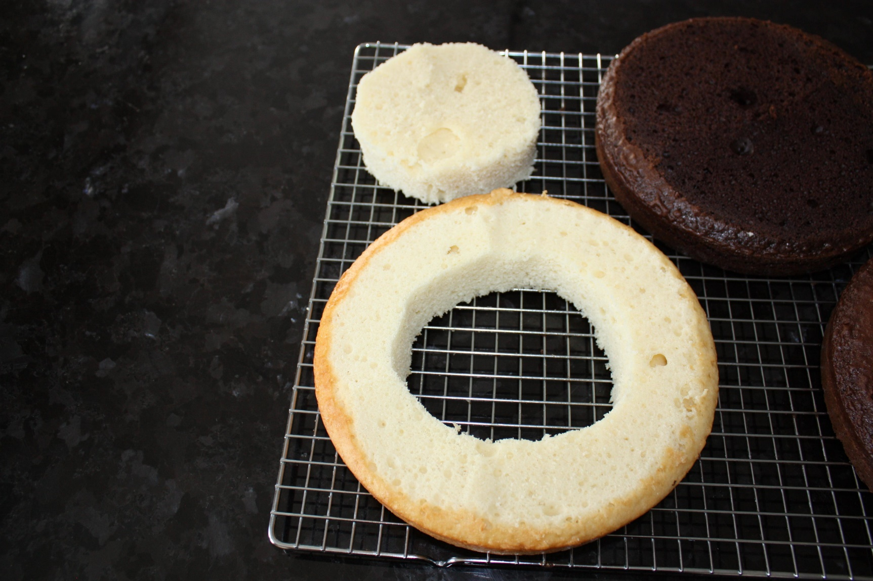
One Solution: Example

Slide 12
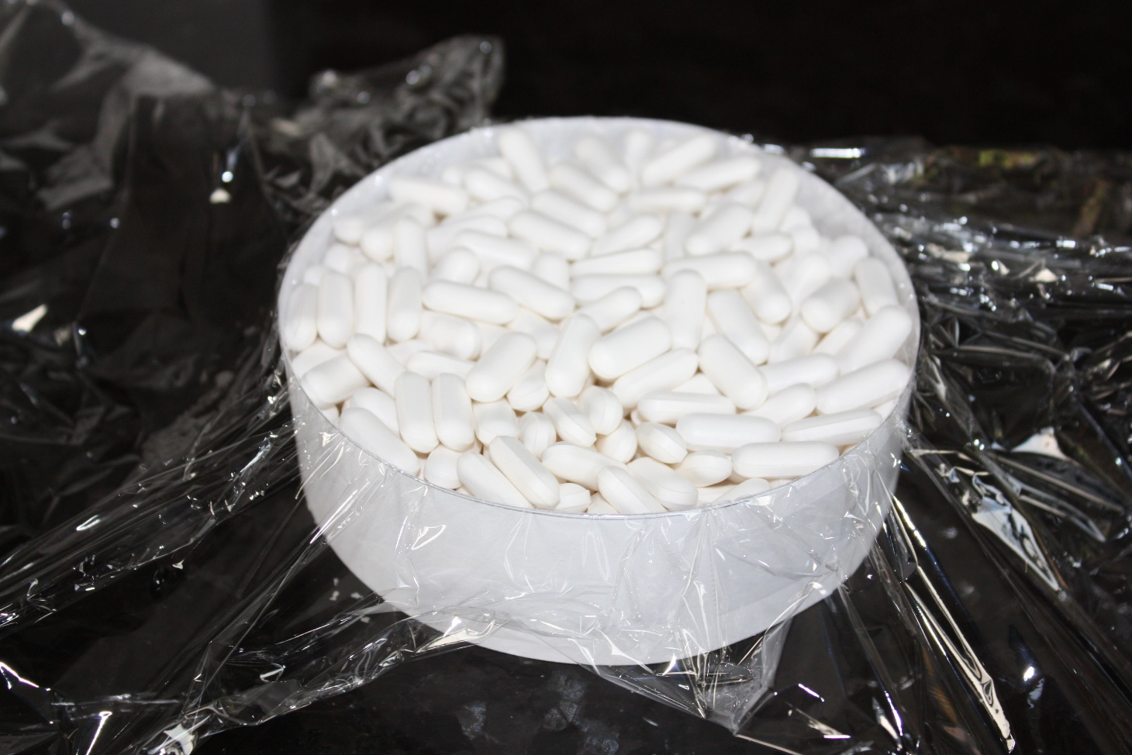
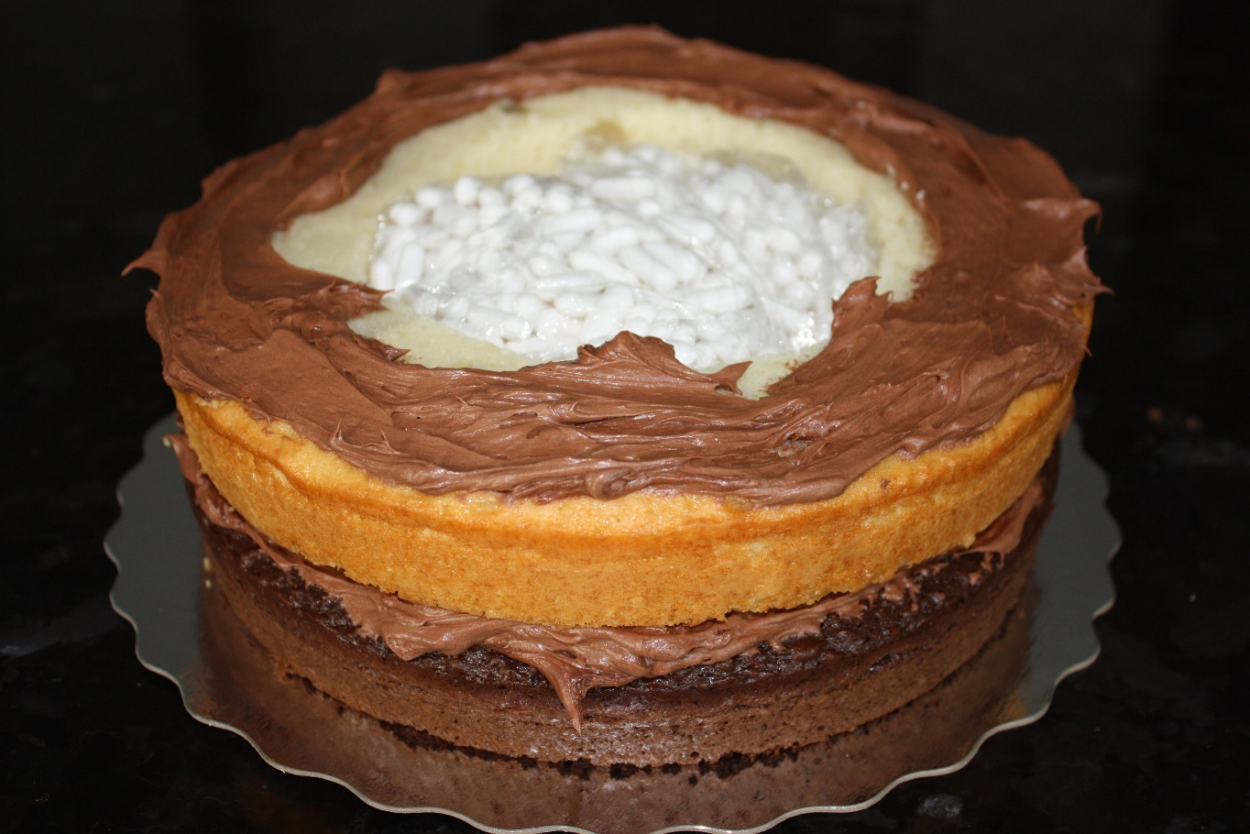
Solution example
420 pills

Slide 13
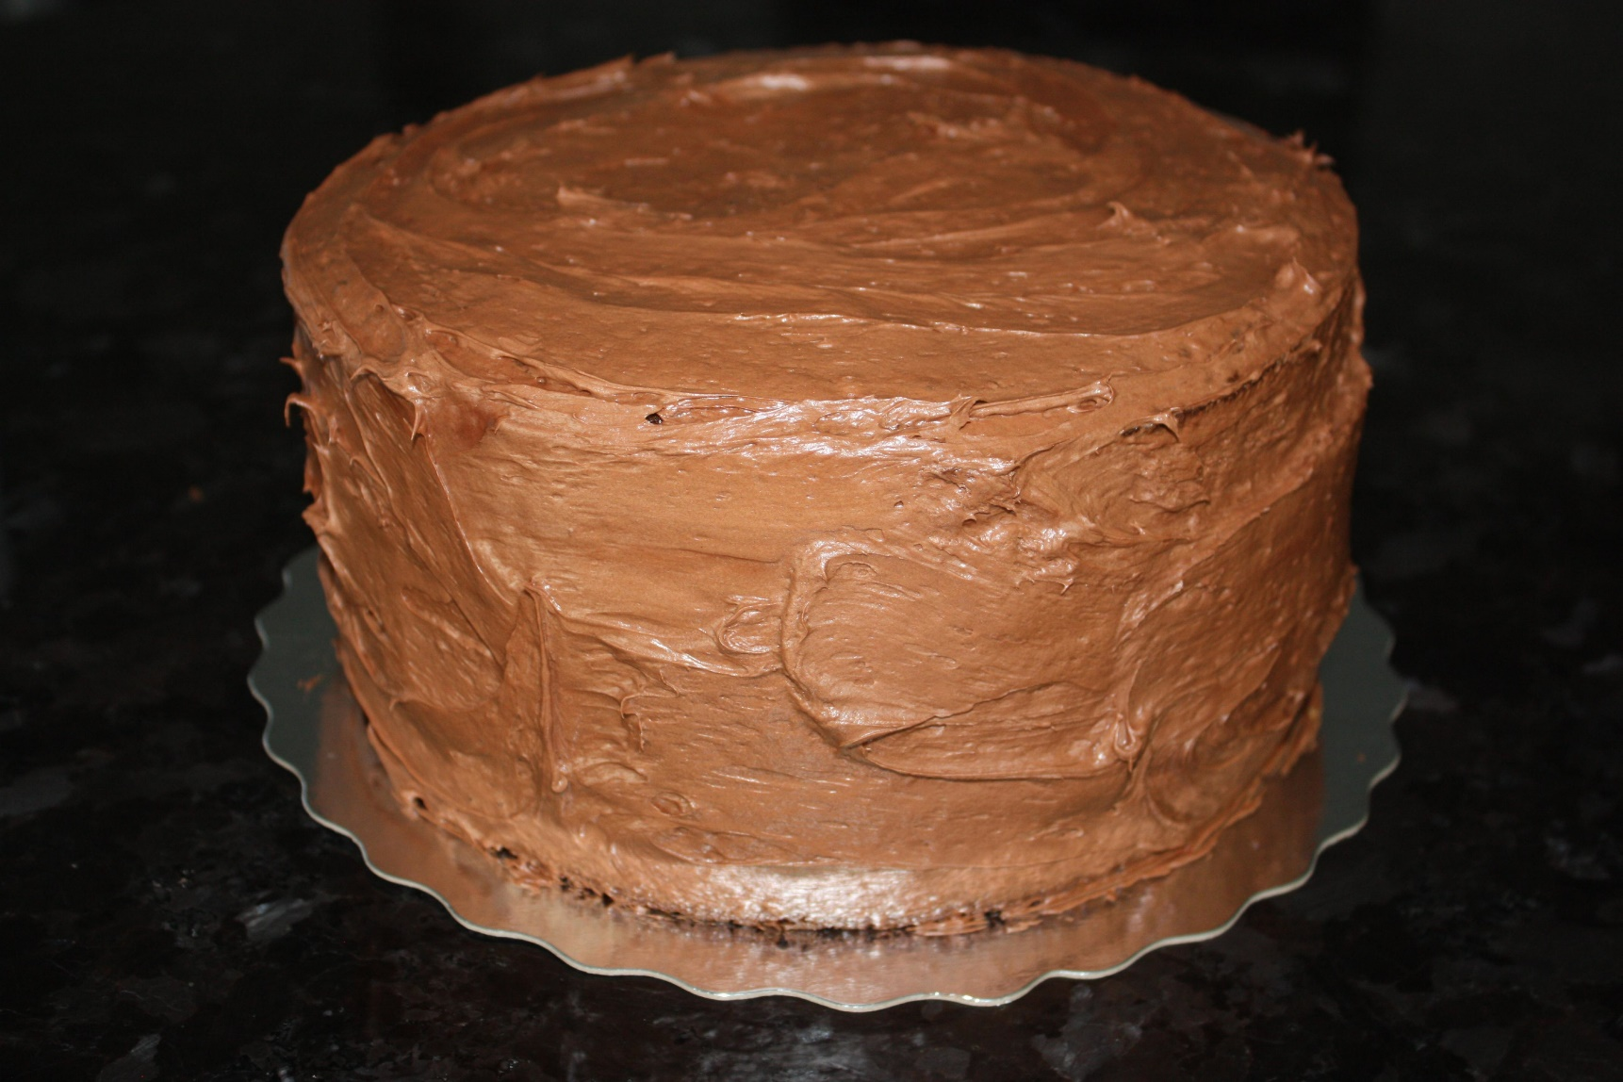
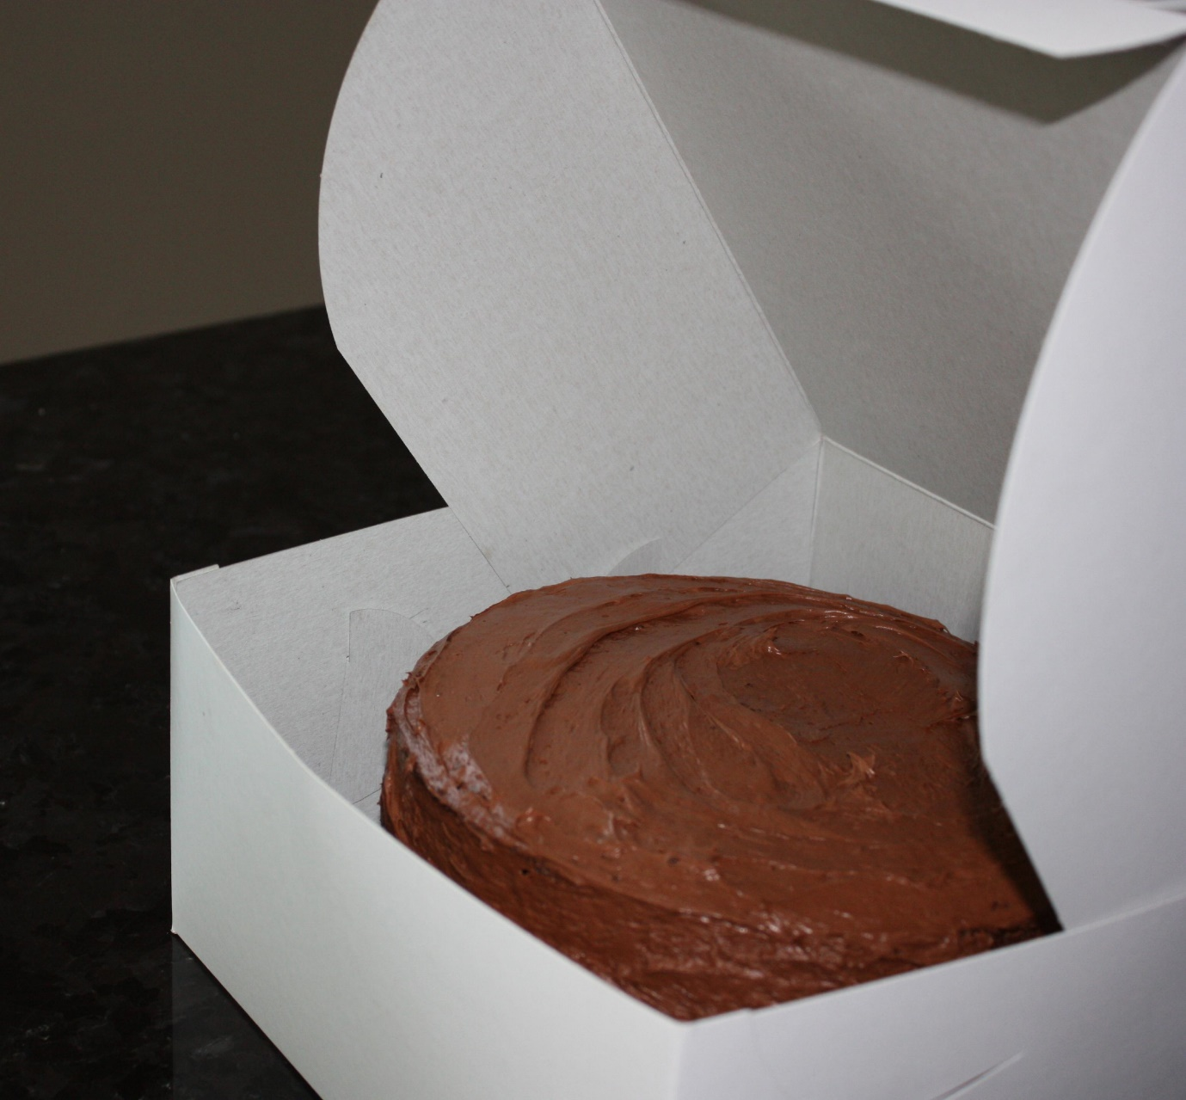
Solution Example

Slide 14
Take-Aways
Many brainstorming methods
Brainstorming generates ideas
Organise those Ideas

